Slide 1


K.RAMAKRISHNAN COLLEGE OF TECHNOLOGY
(AUTONOMOUS), TRICHY
PARCEL TRACKING SYSTEM
PRESENTED BY SUPERVISOR
Pragatheeshwaran E Mrs.K.Valli Priyadharshini M.E., (PhD),
2303811710421118 AP/CSE.

Slide 2
PRESENTATION OVERVIEW
Objective
Project Introduction
Problem Statement
Methodologies (Programming concepts relevant to problem statement)
Architecture of the proposed system
List of Modules
Merits
Results and Discussion
Queries

Slide 3
OBJECTIVE
Help customers and companies see where their parcels are and what’s happening at every step.
Make it easier for customers to trust the system by keeping them updated and worry-free about their deliveries.
Help logistics companies work smarter, fix problems faster, and deliver parcels on time.
2/7/20

Slide 4
PROJECT INTRODUCTION
Enables administrators to register parcels and update their statuses.
Allows customers to track parcels using unique tracking numbers.
Provides notifications for key events like dispatch and delivery.
2/7/20

Slide 5
PROBLEM STATEMENT
Design and develop a Parcel Tracking System that enables customers and logistics companies to track the real-time status and location of parcels from dispatch to delivery.
The system should provide accurate updates at each stage of the parcel's journey, allowing users to monitor the progress and ensure timely delivery.
The goal is to enhance transparency, improve customer satisfaction, and optimize logistics operations by providing reliable tracking information.
2/7/20

Slide 6
METHODOLOGIES
Class and Objects
Swing for GUI (Graphical User Interface)
Event Handling (ActionListeners)
Collections Framework (HashMap)
Exception Handling (Implicitly)
Constructor and Instance Variables
2/7/20

Slide 7
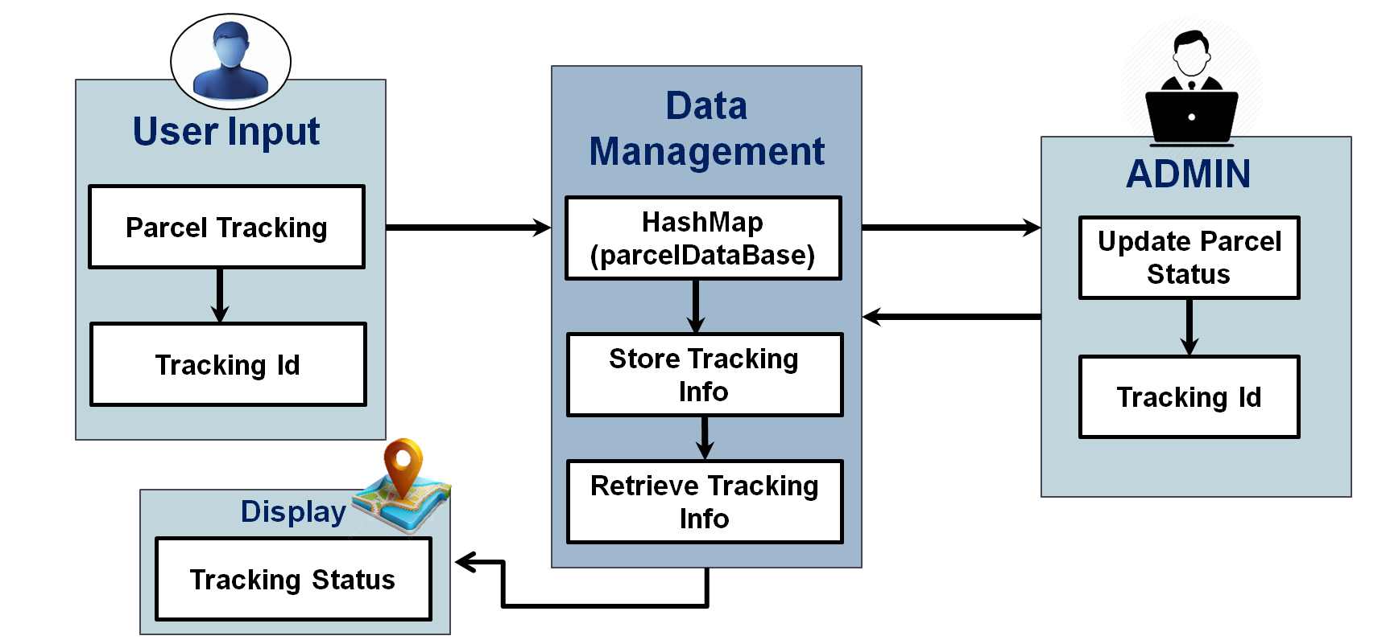
ARCHITECTURE OF THE PROPOSED SYSTEM
2/7/20

Slide 8
LIST OF MODULES
1. Main Module
Purpose: Acts as the entry point for the system and sets up the initial login window.
Key Features:
  Allows the user to choose between Admin and Customer roles.
  Provides a clean interface to access different parts of the application.
2. Update Module (Admin Functionality)
Purpose: Enables the admin to update parcel details in the system.
Key Features:
  Admin can log in using a predefined password.
  Admin can register or update a parcel by providing a Tracking ID, Location, and Status.
  Updates are stored in the parcelDatabase for tracking purposes.
2/7/20

Slide 9
LIST OF MODULES
3. Track Module (Customer Functionality)
Purpose: Allows customers to track their parcels in real-time.
Key Features:
  Customers can enter their Tracking ID to view the current Location and Status of their parcel.
  Displays an error if the Tracking ID is not found.
4. Data Management Module
Purpose: Handles storage and retrieval of parcel data.
Key Features:
  Data is stored in a HashMap where the key is the Tracking ID, and the value is an array containing Location and Status.
  Ensures fast and efficient lookups and updates.
2/7/20

Slide 10
MERITS
Quick Updates:
The system keeps parcel details updated so customers always know where their parcel is.
Simple to Use:
Easy screens for both Admins and Customers make the system hassle-free to operate.
Fast Data Handling:
Parcel information is stored smartly, so the system works quickly without delays.
2/7/20

Slide 11
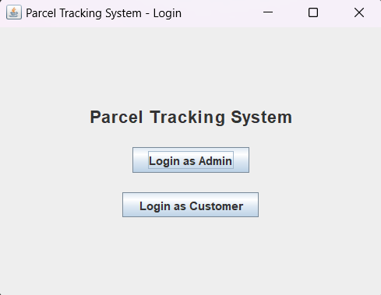
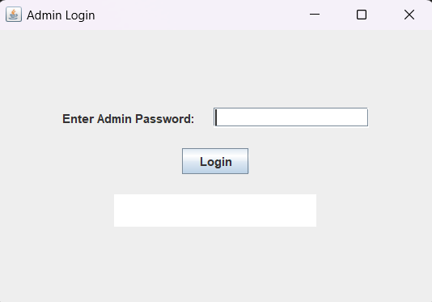
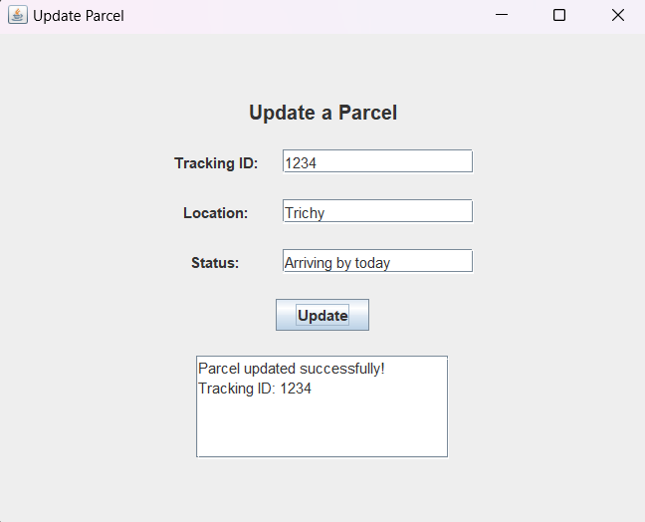
RESULTS AND DISCUSSION
2/7/20

Slide 12
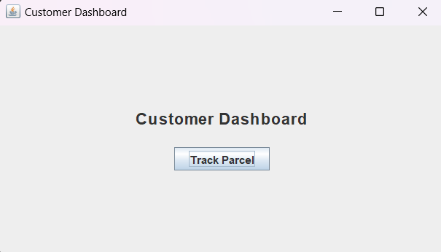
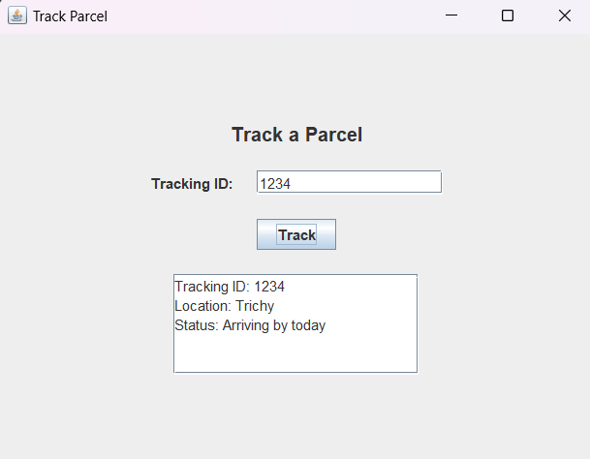
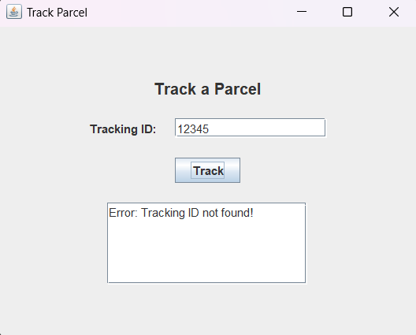
RESULTS AND DISCUSSION
2/7/20

Slide 13
THANK YOU
Queries……?
2/7/20

